Slide 1

CMR College of Engineering & Technology
(UGC Autonomous)
Accredited by NAAC with “A+” Grade
Kandlakoya, Medchal Road, Hyderabad-501401
Department of Computer Science and Engineering
Major Project
GRIEVANCE CENTRAL HUB
Under esteemed guidance of
Mr. J. Ranjith
Assistant Professor
Team Members ( batch no. 59 ) :
A. Ashlesha (20H51A0501)
G. Rohith Reddy (20H51A05E0)
A. Ujwala (20H51A05M8)

Slide 2
Outline
Abstract
Introduction
Research objective
Problem definition
Scope of the project
Literature Review
Implementation of Existing system
Conclusion
References

Slide 3
Abstract

Slide 4
ABSTRACT
The aim of this portal is to handle grievances raised by an individual in an organization efficiently and transparently.
The portal contains a user friendly interface that is accessible to all.
The portal aims at providing confidentiality and security.
The portal focuses on transparency by offering real-time tracking and updates on the status of grievances, ensuring that both students and faculty are informed throughout the resolution journey

Slide 5
Introduction

Slide 6
INTRODUCTION
A centralized grievance system portal is an online platform designed to facilitate the management and resolution of complaints across different departments or organizations.
It provides a single point of contact for individuals within an organization to file grievances related to any issues within the organization.
The portal manages grievances efficiently by registration, tracking, monitoring of complaints.

Slide 7
Research Objective

Slide 8
OBJECTIVE OF THE PROJECT
The aim of this portal is to handle grievances raised by an individual in an organization efficiently and resolve them.
The portal should contain a user-friendly interface that is accessible to all.
The portal should provide confidentiality and security.

Slide 9
Problem definition

Slide 10
PROBLEM DEFINITION
Inefficient Grievance Handling: The current grievance management processes are inefficient, causing delays in resolving complaints and eroding public trust in government services.
Lack of Transparency: Without a centralized system, there's a lack of transparency, hindering the government's ability to analyze grievance data for service improvements.

Slide 11
Scope of the project

Slide 12
Scope of the project
To provide a single point of contact for students to register complaints related to college.
To improve transparency by allowing students to track the status of their complaints in real-time.
To simplify the complaint handling process by providing a centralized platform for college officials to receive, investigate, and resolve complaints.
To enhance the delivery of services by addressing the grievances of students and ensuring timely redressal of their complaints.

Slide 13
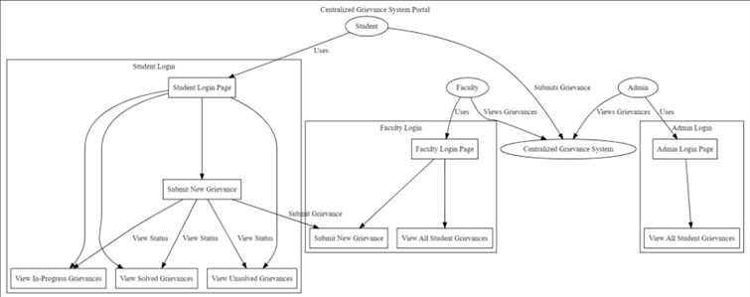

Slide 14
Literature Review

Slide 15
LITERATURE REVIEW
S.NO | TITLE | TECHNOLOGIES/ METHODS | LIMITATIONS
1. | Traditional paper-based Grievance system | Paper forms, manual processing | Inefficient data management, Limited data analytics
2. | Email & phone-based Grievance system | Email, phone calls, manual tracking | Potential overload, Limited automation
3. | Fragmented digital Grievance system - by Karan Gulati from university of Hamburg | Web Form(JS, NodeJs, MongoDB), Email integration(python, exchange server), Phone server(Twilio) | Lack of centralization, Interoperability issues

Slide 16
Implementation of existing solutions

Slide 17
Implementation of existing solutions
There are several existing systems for centralized grievance system that are currently in use. Some of them are:
Traditional paper-based Grievance system
Email and phone based Grievance system
Fragmented Digital Grievance system

Slide 18
Conclusion

Slide 19
CONCLUSION
The centralized grievance system portal we develop provides an efficient and transparent approach to grievance redressal.
With more personal interaction for grievance resolution, this portal has the potential to improve the way grievances are handled.
The user friendly interface of the portal ensures anyone can submit their grievances easily.

Slide 20
References

Slide 21
REFERENCES (BASE PAPERS)
W3Schools
jQuery Documentation
Tailwind CSS Documentation
Apache Tomcat
Jincy Denny, Ramya Chanda, Sweta Rani Lenka, A. Srija Reddy, Sahithya Vallabaneni. “A Web Portal for Student Grievance Support System” International Research Journal of Engineering and Technology (IRJET), Volume: 08, Issue: 05

Slide 22
THANK YOU

